Slide 1
Levels of Organisation
Year 11 Human Biology
ATAR
PowerPoint #1

Slide 2
SCSA Syllabus Reference
The human body is comprised of cells, tissues and organs within complex systems that work together to maintain life

Slide 3
Lesson Intention
To review the levels of organisation in an organism

Slide 4
Success Criteria
Students can ….
identify the levels of organisation from smallest to largest
state examples for each structural level e.g. muscle cells
define each level of organisation (cell, tissue, organ, organ system)
recognise the Cell Theory states that all organisms are made of cells, which are the basic unit of life and arise from pre-existing cells.

Slide 5
Vocabulary
Cell: the smallest structural and functional unit of an organism
Cell Theory: the principle that all living organisms are made up of cells and the material produced by cells.
Tissue: a group of cells that are similar in structure and function
Organ: a structure made up of different types of tissue working together
Organ system: a group of organs that work together to perform a certain function in an organism.

Slide 6
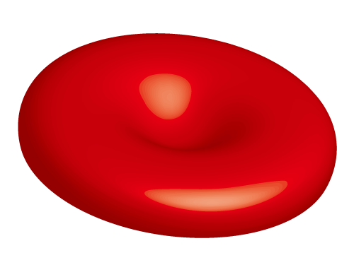
Cells
The lowest structural level
Are specialised to carry out different functions
E.g. muscle cells are able to shorten in length
E.g. red blood cells are able to transport oxygen
Red blood cell

Slide 7
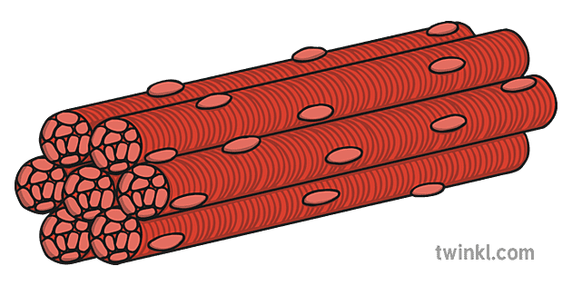
Tissues
Cells with similar specialisations that carry out a common function are grouped together into tissues.
E.g. groups of muscle cells make up muscle tissue
E.g. groups of nerve cells make up nervous tissue
Skeletal muscle tissue

Slide 8
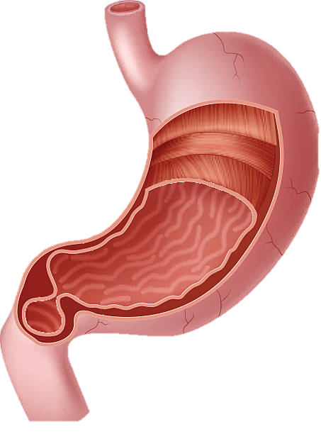
Organ
Different types of tissues work together as organs
Normally made up of two or more tissues working together
E.g. the stomach is an organ with epithelial tissue on the inside and muscle tissue in the wall.
Stomach

Slide 9
Organ System
The highest level of organisation
A group of organs that work together for a common purpose
E.g. the respiratory system supplies oxygen and removes carbon dioxide from the blood. The organs include the lungs, diaphragm, intercostal muscles, ribs, trachea, larynx and nose.

Slide 10
Cell Theory
The Cell Theory is a basic principle of biology
It has three principles
All living organisms are composed of one or more cells.
The cell is the basic unit of structure and organisation in organisms.
Cells arise from pre-existing cells.

Slide 11
Recall Knowledge
State the Cell Theory
Why do we use a microscope to view cells?
List the Levels of Organisation from smallest to largest

Slide 12
Apply Knowledge
Explain the difference between tissues and organs.

Slide 13
Homework
Choose two body systems and list the organs that are part of each of those systems

Slide 14
Reading
Page 63: How Cells Make a Body (top half of the page)
Page 26: Cells (top half of the page)

